Slide 1
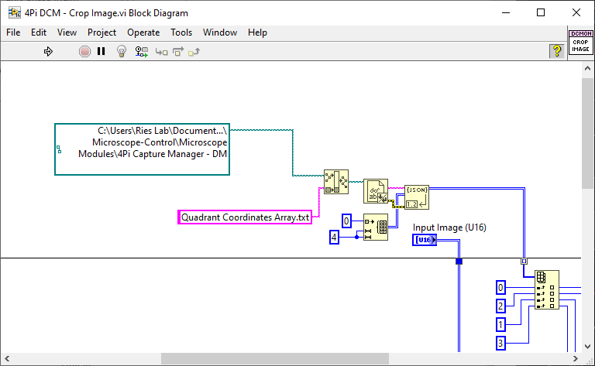
4Pi DCM - Crop Image.vi
Change the path contains Quadrant Coordinates Array.txt

Slide 2
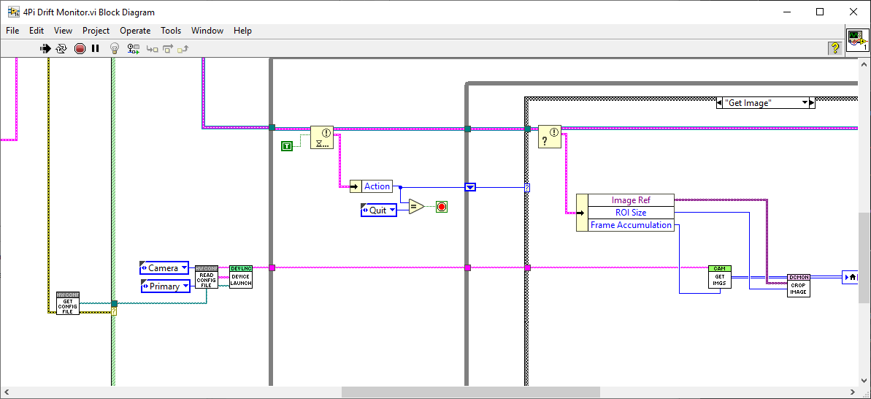
4Pi Drift Monitor.vi
Also check the VI path under “Get Initial Image”
Those are generic VIs, you might need to update the path

Slide 3
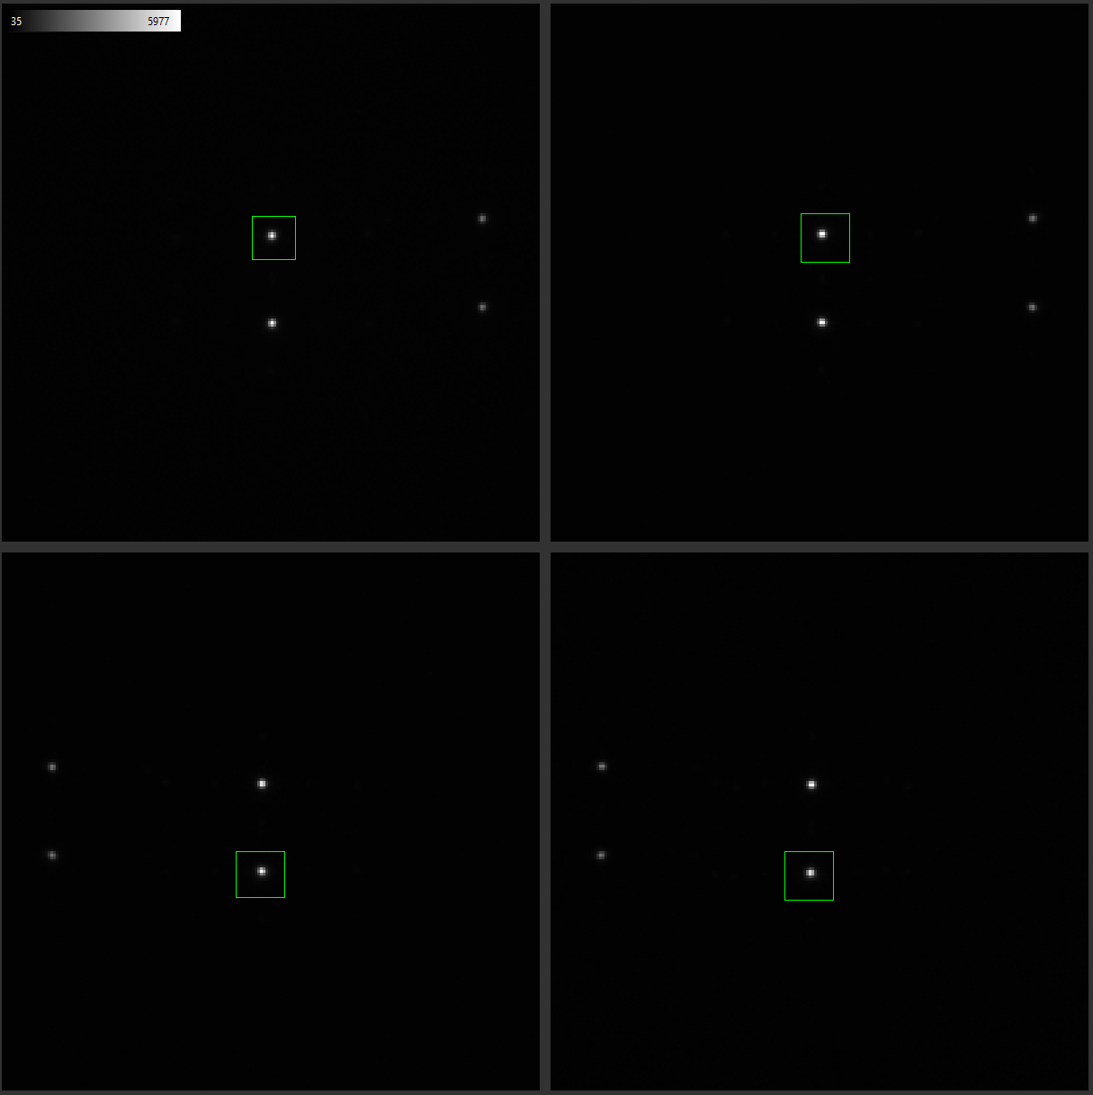
1
2
Use the rectangular tools to select a bead in each quadrant. The rectangular size doesn’t matter, the crop center is defined as the center of each rectangular, the crop size is defined in the GUI.
You can select two beads from the top objectives and two from the bottom to monitor the positions from both objectives at the same time (as shown in the figure).
top
3
4
bottom

Slide 4
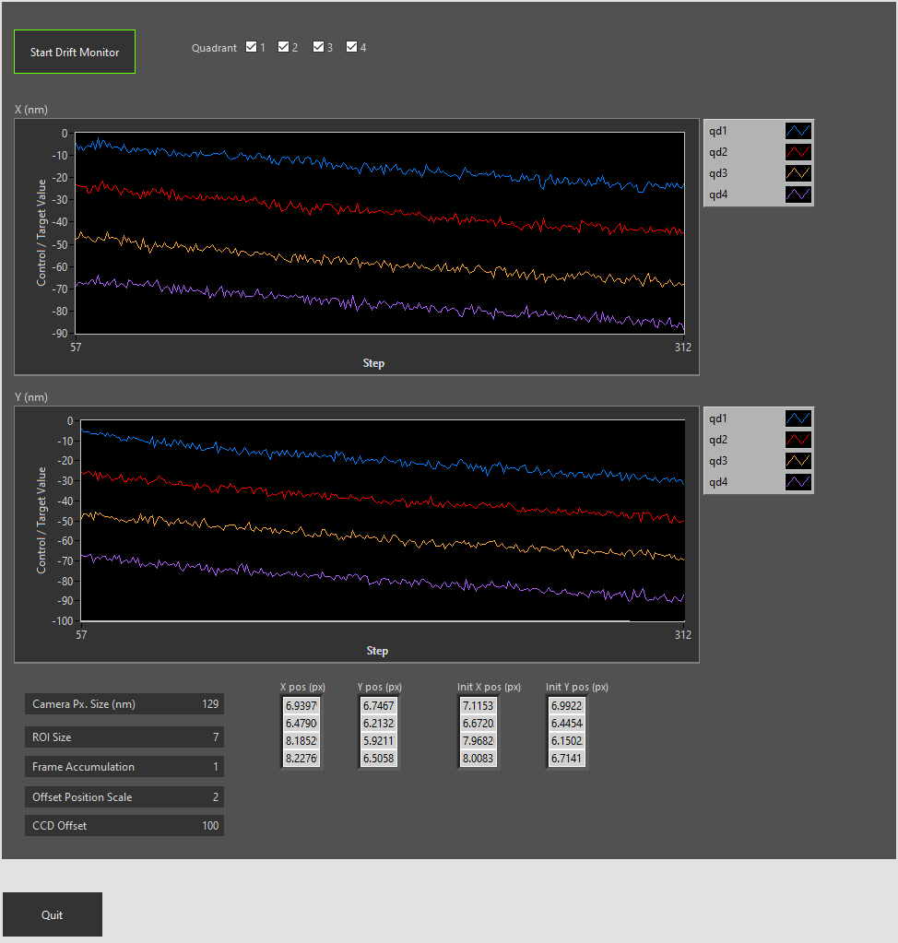
Uncheck the quadrant, the position will be zero + offset
Camera pixel size
Crop size = ROI Size x 2 + 1
Adjust separation between lines

